Slide 1
ATAI
Advanced Technique of Artificial Intelligence
ATAI
ChongqingUniversity _{AdvancedTechniqueof}
of Technology Artificial Intelligence
Chongqing University of
Technology
Chongqing University ^{ATAI}
_{of Technology} Advanced Techniqueof
Artificial Intelligence
Chongqing University of Technology
Chongqing University of Technology
Mitigating Social Hazards Early Detection of Fake News
via Diffusion-Guided Propagation Path Generation
Code : https://anonymous.4open.science/r/DGA-Fake-1D5F/
—— ACM MM’2024
Reported by Yang Jiang
1

Slide 2
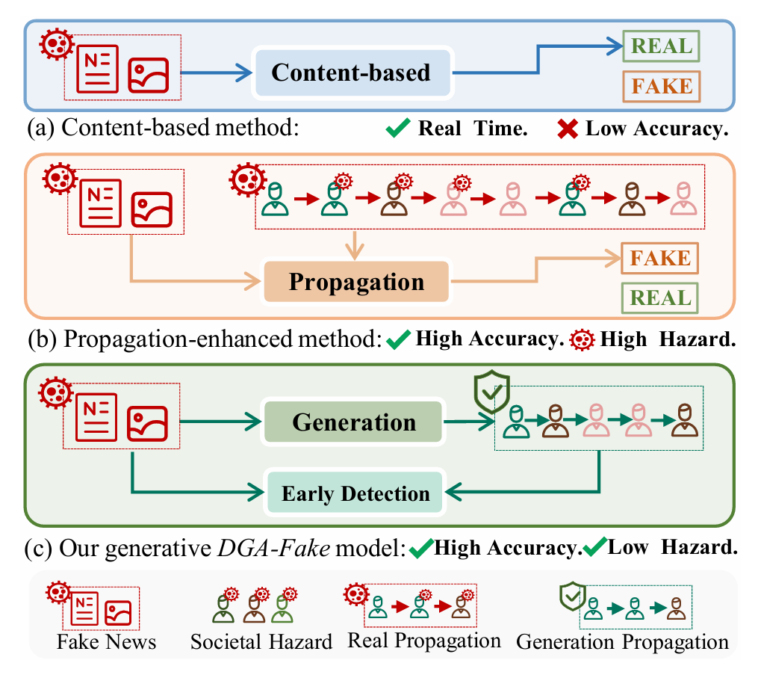
ATAI
Advanced Technique of Artificial Intelligence
ATAI
ChongqingUniversity _{AdvancedTechniqueof}
of Technology Artificial Intelligence
Chongqing University of
Technology
Chongqing University ^{ATAI}
_{of Technology} Advanced Techniqueof
Artificial Intelligence
Chongqing University of Technology
Chongqing University of Technology
Introduction
The abundant social context within extensive propagation paths is crucial for successful detection. On the other side of the coin, sufficient propagation paths also indicate that the fake news has already achieved widespread dissemination, leading to substantial social hazards.

Slide 3
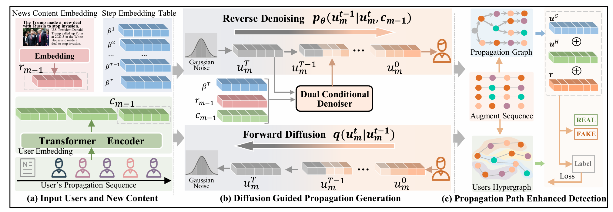
ATAI
Advanced Technique of Artificial Intelligence
ATAI
ChongqingUniversity _{AdvancedTechniqueof}
of Technology Artificial Intelligence
Chongqing University of
Technology
Chongqing University ^{ATAI}
_{of Technology} Advanced Techniqueof
Artificial Intelligence
Chongqing University of Technology
Chongqing University of Technology
Overview

Slide 4
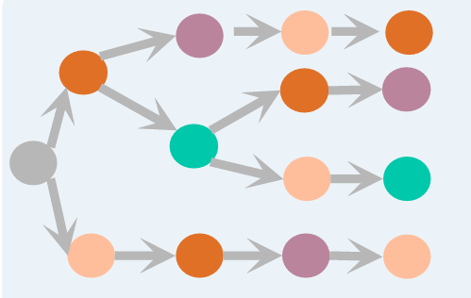
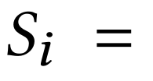
ATAI
Advanced Technique of Artificial Intelligence
ATAI
ChongqingUniversity _{AdvancedTechniqueof}
of Technology Artificial Intelligence
Chongqing University of
Technology
Chongqing University ^{ATAI}
_{of Technology} Advanced Techniqueof
Artificial Intelligence
Chongqing University of Technology
Chongqing University of Technology
Preliminary

Slide 5
ATAI
Advanced Technique of Artificial Intelligence
ATAI
ChongqingUniversity _{AdvancedTechniqueof}
of Technology Artificial Intelligence
Chongqing University of
Technology
Chongqing University ^{ATAI}
_{of Technology} Advanced Techniqueof
Artificial Intelligence
Chongqing University of Technology
Chongqing University of Technology
Preliminary
Forward Process.
Reverse Process.

Slide 6
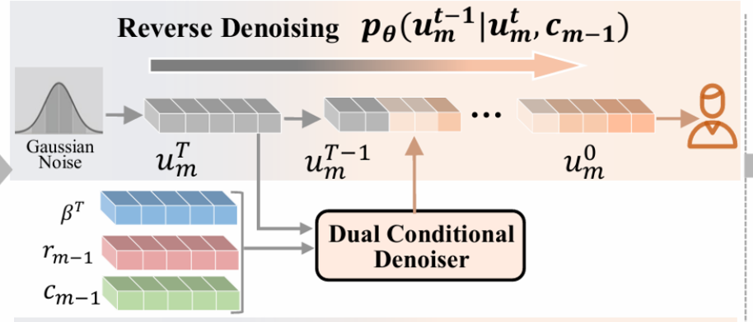
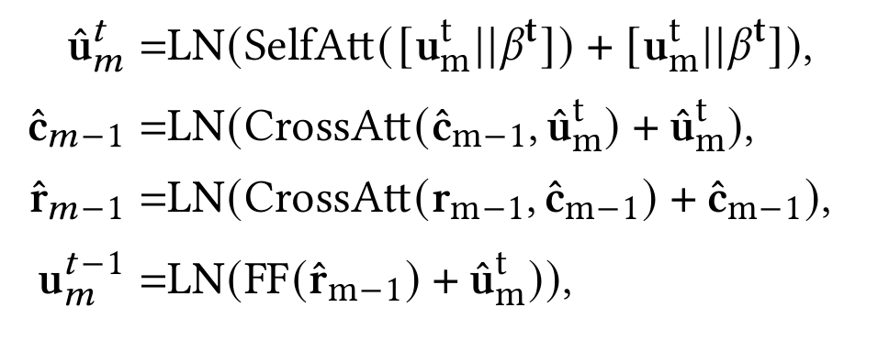
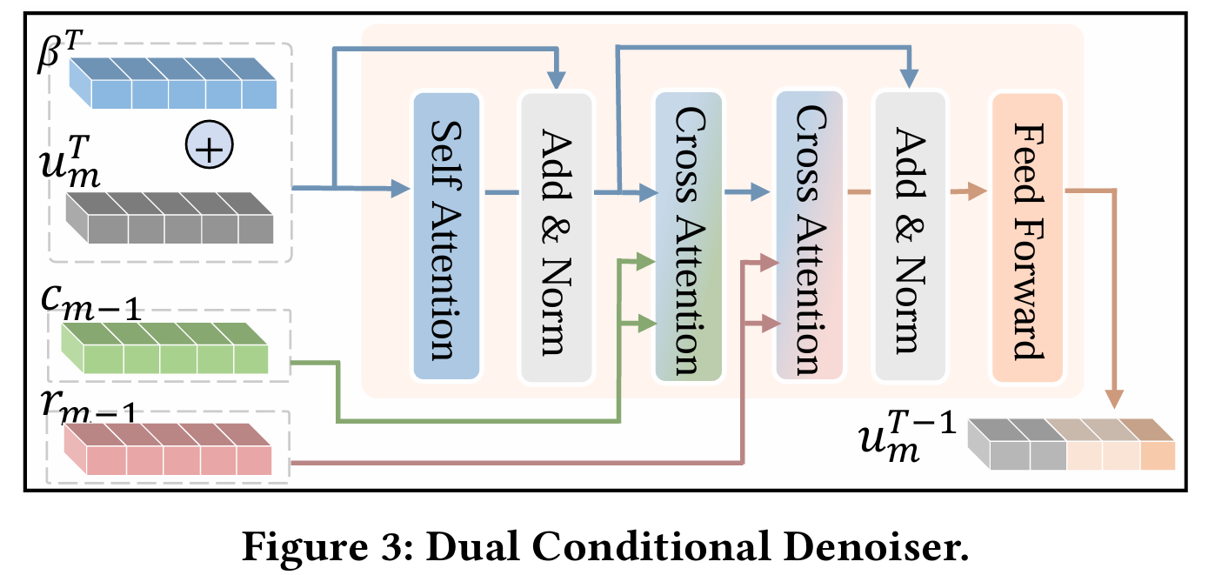
ATAI
Advanced Technique of Artificial Intelligence
ATAI
ChongqingUniversity _{AdvancedTechniqueof}
of Technology Artificial Intelligence
Chongqing University of
Technology
Chongqing University ^{ATAI}
_{of Technology} Advanced Techniqueof
Artificial Intelligence
Chongqing University of Technology
Chongqing University of Technology
Method

Slide 7
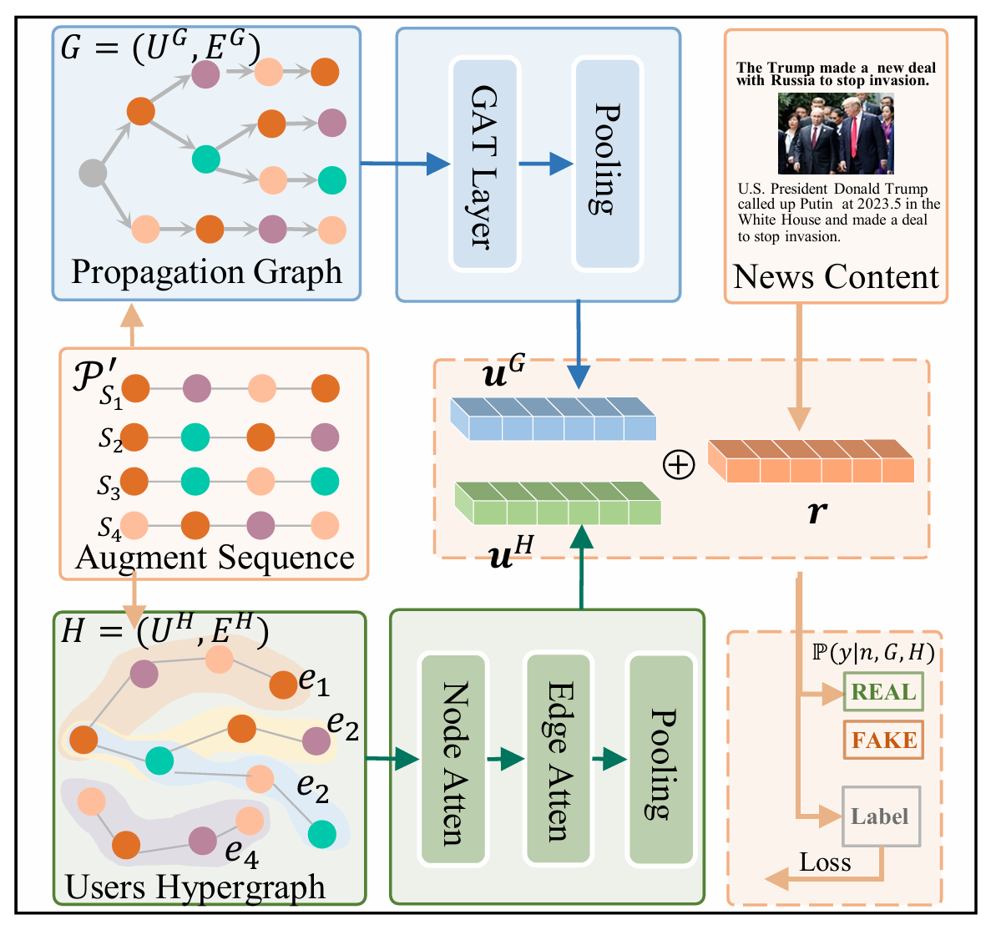
ATAI
Advanced Technique of Artificial Intelligence
ATAI
ChongqingUniversity _{AdvancedTechniqueof}
of Technology Artificial Intelligence
Chongqing University of
Technology
Chongqing University ^{ATAI}
_{of Technology} Advanced Techniqueof
Artificial Intelligence
Chongqing University of Technology
Chongqing University of Technology
Method

Slide 8
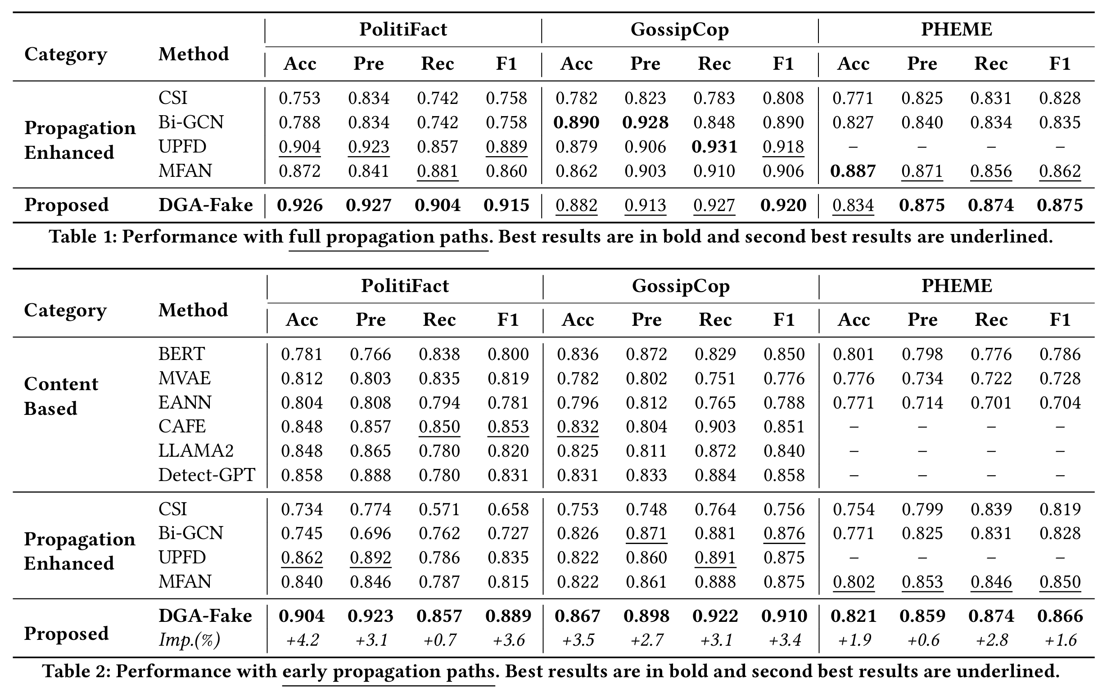
ATAI
Advanced Technique of Artificial Intelligence
ATAI
ChongqingUniversity _{AdvancedTechniqueof}
of Technology Artificial Intelligence
Chongqing University of
Technology
Chongqing University ^{ATAI}
_{of Technology} Advanced Techniqueof
Artificial Intelligence
Chongqing University of Technology
Chongqing University of Technology
Experiments

Slide 9
ATAI
Advanced Technique of Artificial Intelligence
ATAI
ChongqingUniversity _{AdvancedTechniqueof}
of Technology Artificial Intelligence
Chongqing University of
Technology
Chongqing University ^{ATAI}
_{of Technology} Advanced Techniqueof
Artificial Intelligence
Chongqing University of Technology
Chongqing University of Technology
Experiments

Slide 10
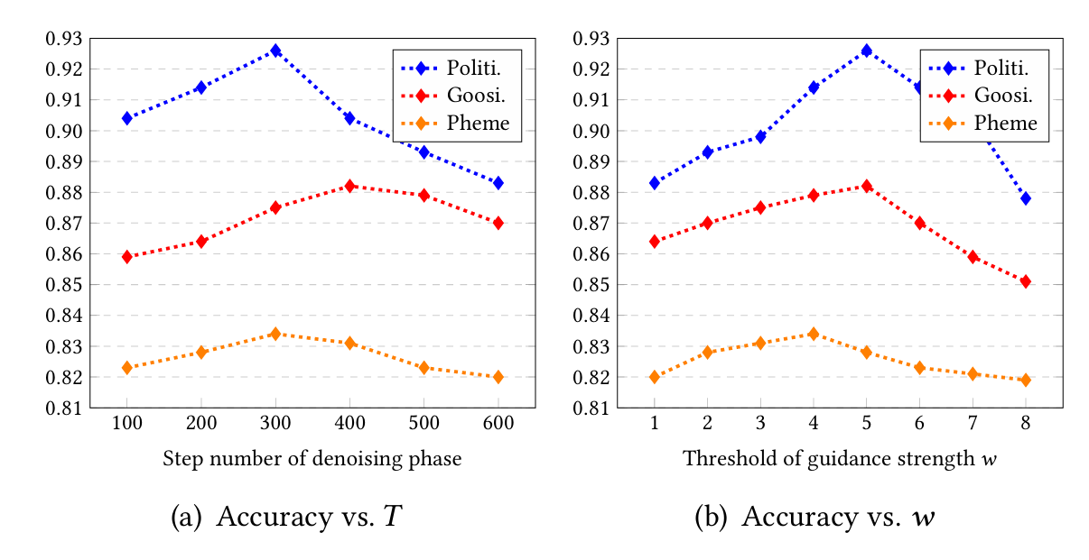
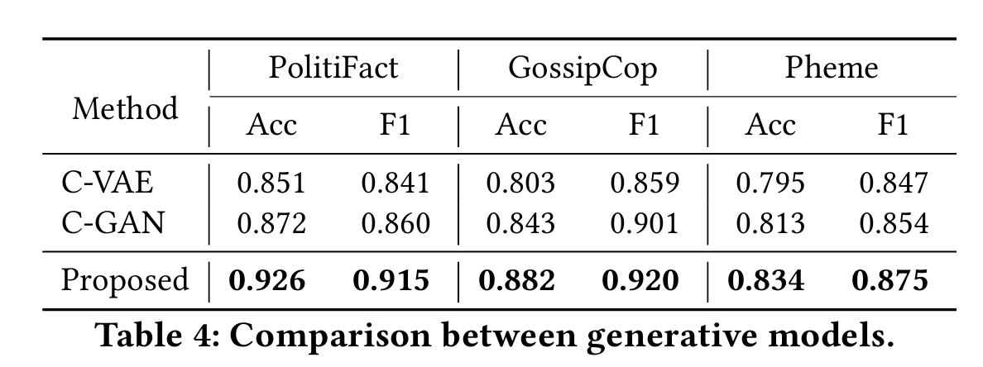
ATAI
Advanced Technique of Artificial Intelligence
ATAI
ChongqingUniversity _{AdvancedTechniqueof}
of Technology Artificial Intelligence
Chongqing University of
Technology
Chongqing University ^{ATAI}
_{of Technology} Advanced Techniqueof
Artificial Intelligence
Chongqing University of Technology
Chongqing University of Technology
Experiments

Slide 11
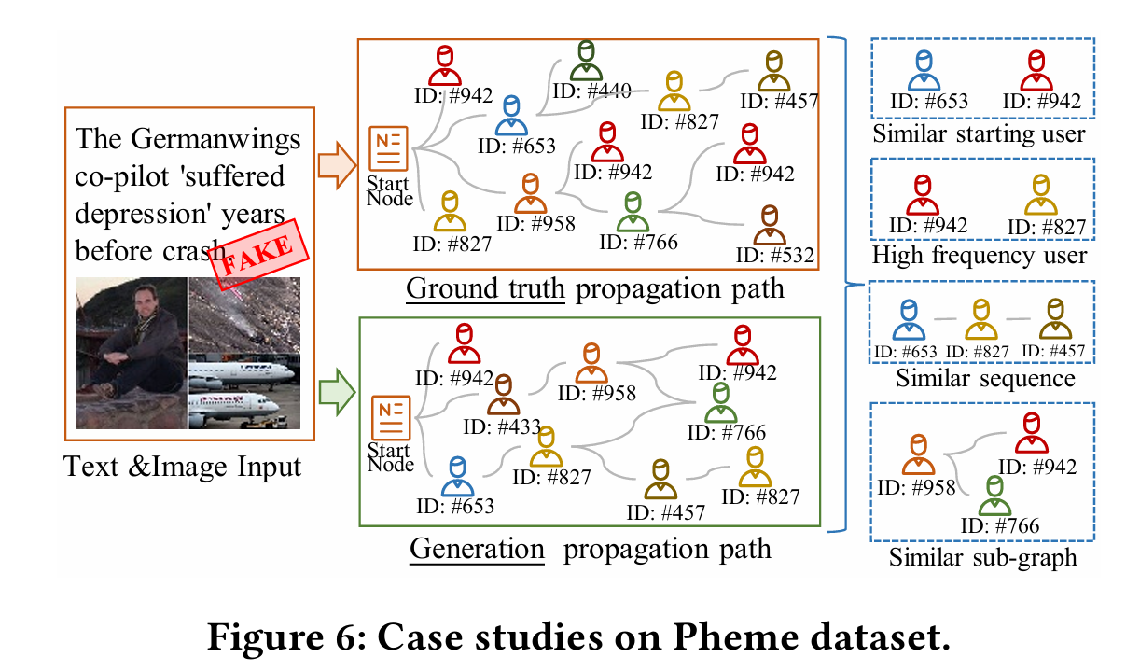
ATAI
Advanced Technique of Artificial Intelligence
ATAI
ChongqingUniversity _{AdvancedTechniqueof}
of Technology Artificial Intelligence
Chongqing University of
Technology
Chongqing University ^{ATAI}
_{of Technology} Advanced Techniqueof
Artificial Intelligence
Chongqing University of Technology
Chongqing University of Technology
Experiments

Slide 12
ATAI
Advanced Technique of Artificial Intelligence
ATAI
ChongqingUniversity _{AdvancedTechniqueof}
of Technology Artificial Intelligence
Chongqing University of
Technology
Chongqing University ^{ATAI}
_{of Technology} Advanced Techniqueof
Artificial Intelligence
Chongqing University of Technology
Chongqing University of Technology
Thanks!

